Slide 1
Game Theory
INFO 4220 – Networks II: Market Design

Slide 2
Recap
We discussed thick markets and how they lead to an equilibrium of demand and supply
  And the equilibrium was efficient as it maximizes economic welfare
We started talking about game theory
  We did a game in which we could not get people to behave in a mutually beneficial way
These two concepts will be important throughout the semester:
  We want markets to be efficient. With prices and WTA/WTP is easy to determine. Without prices we will have to use different concepts.
  When studying markets, we want a framework to analyze agents’ behavior. Game theory is ideal for this.

Slide 3
In this lecture:
We will continue talking about Game Theory:
  Introduce the concept of equilibrium in dominant strategies
  Introduce Nash Equilibrium
  Explain what is a Pareto superior outcome
  Introduce games of incomplete information
  Explain how we find a Nash Equilibrium in games of incomplete information
We will discuss why we talk about game theory in a market design course

Slide 4
What is Game Theory
Is a set of tools to analyze strategic decision making for a group of actors and predict outcomes
Strategic decision making refers to decision where the actions taken by one actor influences the actions and outcomes of other actors
It has been used in many settings, including economics, military studies, political science, etc.
We will use it because in markets and network industries the actions and outcomes of different players are influenced by the network

Slide 5
Types of Games
There are two main times of games:
  Normal Form: All players choose their actions simultaneously
  Extensive Form: Players choose their actions sequentially
We can also distinguish by types of actions:
  Pure strategy: Players use a single strategy from the set of available strategies
  Mixed strategies: Players assign a probability to playing each strategy (for example they toss a coin to choose what to do)
We also assume that players are rational and know the structure, the rules, and the payoffs of the game. These are called games with perfect information.

Slide 6
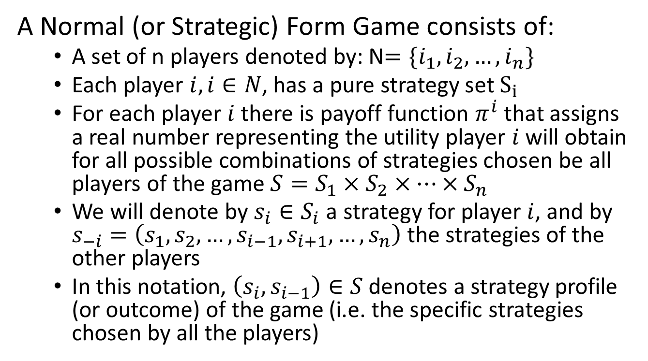
Definition of a Game
A Normal (or Strategic) Form Game consists of:
  A set of n players denoted by: N$=\{i_{1},i_{2},…,i_{n}\}$
  Each player $i,i∈N$, has a pure strategy set $S_{i}$
  For each player $i$ there is payoff function $π^{i}$ that assigns a real number representing the utility player $i$ will obtain for all possible combinations of strategies chosen be all players of the game $S=S_{1}×S_{2}×…×S_{n}$
  We will denote by $s_{i}∈S_{i}$ a strategy for player $i$, and by $s_{−i}=\left(s_{1},s_{2},…,s_{i−1},s_{i+1},…,s_{n}\right)$ the strategies of the other players
  In this notation, $\left(s_{i},s_{i−1}\right)∈S$ denotes a strategy profile (or outcome) of the game (i.e. the specific strategies chosen by all the players)

Slide 7
Example of a Game
Alice and Bob are playing the following card game. Each of them has a red card and a black card. Playing the red card give 400 points to the other player (i.e. if Alice plays the red card, Bob gets 400 points). Playing the black card give 300 points to yourself (i.e. if Alice plays the black card, she gets 300 points). Both players reveal the card they play at the same time.

Slide 8
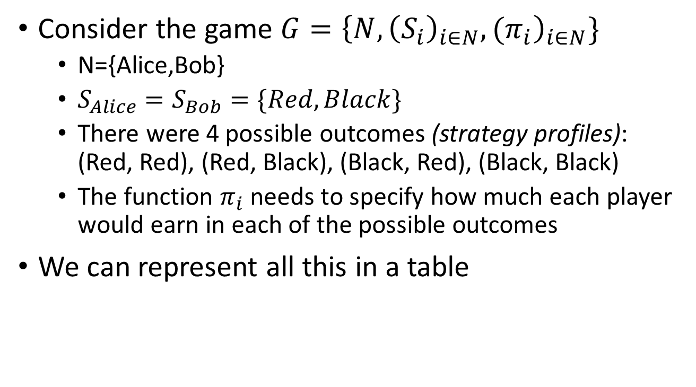
Example of a Game
Consider the game $G={\left\{N,{\left(S_{i}\right)}_{i∈N},{(π}_{i}\right)}_{i∈N}\}$
  N={Alice,Bob}
  $S_{Alice}=S_{Bob}=\{Red, Black\}$
  There were 4 possible outcomes (strategy profiles): (Red, Red), (Red, Black), (Black, Red), (Black, Black)
  The function $π_{i}$ needs to specify how much each player would earn in each of the possible outcomes
We can represent all this in a table

Slide 9
Representation in Matrix Form
 | Bob
Alice |  | Red | Black
 | Red | (400, 400) | (0, 700)
 | Black | (700, 0) | (300, 300)
Normal form games are usually represented in a matrix. The matrix above shows the game in the example
This game above is typically referred as the prisoners’ dilemma
This simple game applies to many settings. For example, firms engaging in price wars, or the game we played in the previous lecture

Slide 10
Equilibrium
Outlining all the possible outcomes and payoffs tells us little about the game
What we want is to be able to predict how a game is going to end
We also need to define characteristics that equilibrium outcomes should have:
  Ideally, we want a single outcome, i.e. a unique equilibrium
  Equilibrium may not be unique, or may not exist at all

Slide 11
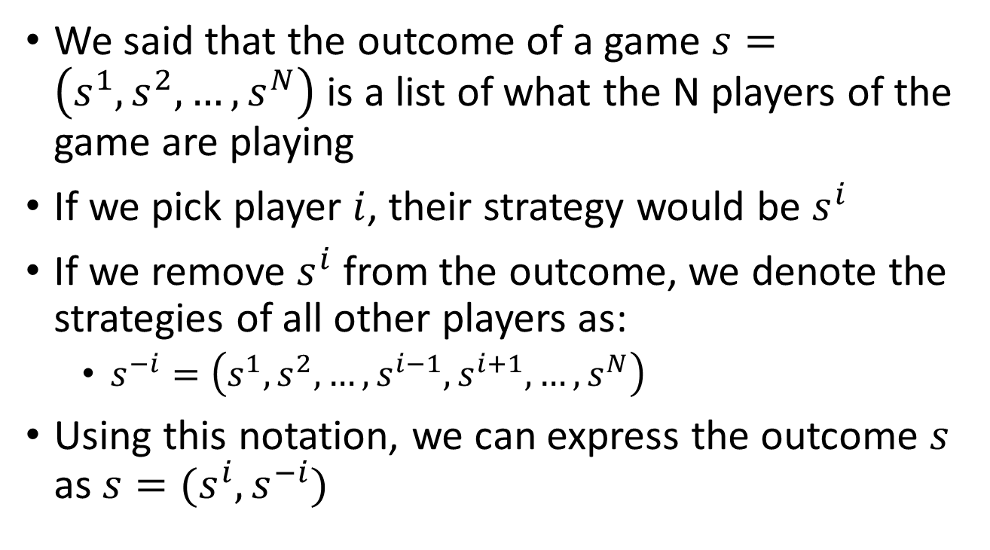
Notation
We said that the outcome of a game $s=\left(s^{1},s^{2},…, s^{N}\right)$ is a list of what the N players of the game are playing
If we pick player $i$, their strategy would be $s^{i}$
If we remove $s^{i}$ from the outcome, we denote the strategies of all other players as:
  $s^{−i}=\left(s^{1},s^{2},…,s^{i−1}, s^{i+1},…, s^{N}\right)$
Using this notation, we can express the outcome $s$ as $s=(s^{i}, s^{−i})$

Slide 12
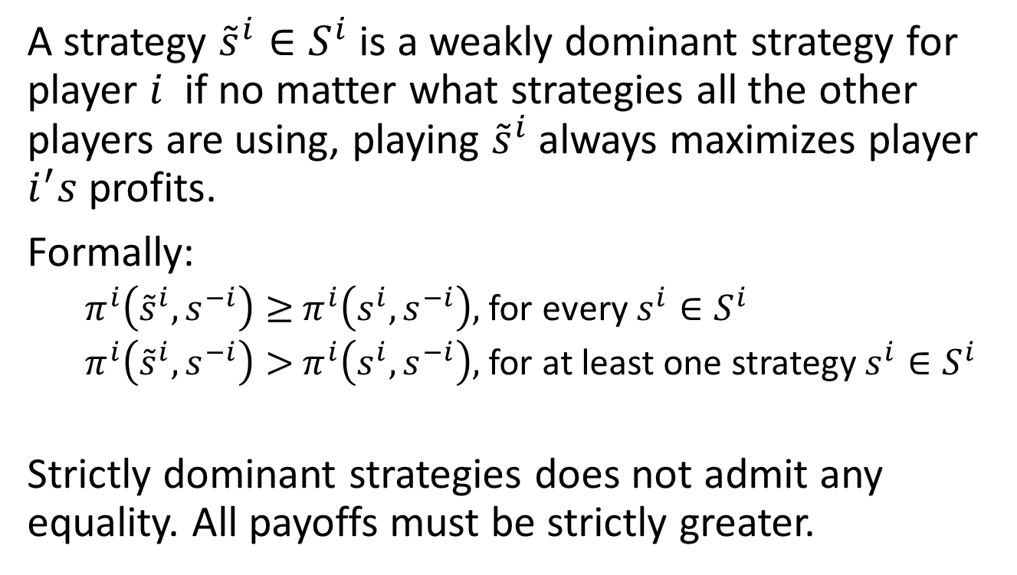
Dominant Strategies
A strategy ${\tilde{s}}^{i}∈S^{i}$ is a weakly dominant strategy for player $i$ if no matter what strategies all the other players are using, playing ${\tilde{s}}^{i}$ always maximizes player $i^{′}s$ profits.
Formally:
  $π^{i}\left({\tilde{s}}^{i},s^{−i}\right)≥$ $π^{i}\left(s^{i},s^{−i}\right),$ for every $s^{i}∈S^{i}$
  $π^{i}\left({\tilde{s}}^{i},s^{−i}\right)>$ $π^{i}\left(s^{i},s^{−i}\right),$ for at least one strategy $s^{i}∈S^{i}$
Strictly dominant strategies does not admit any equality. All payoffs must be strictly greater.

Slide 13
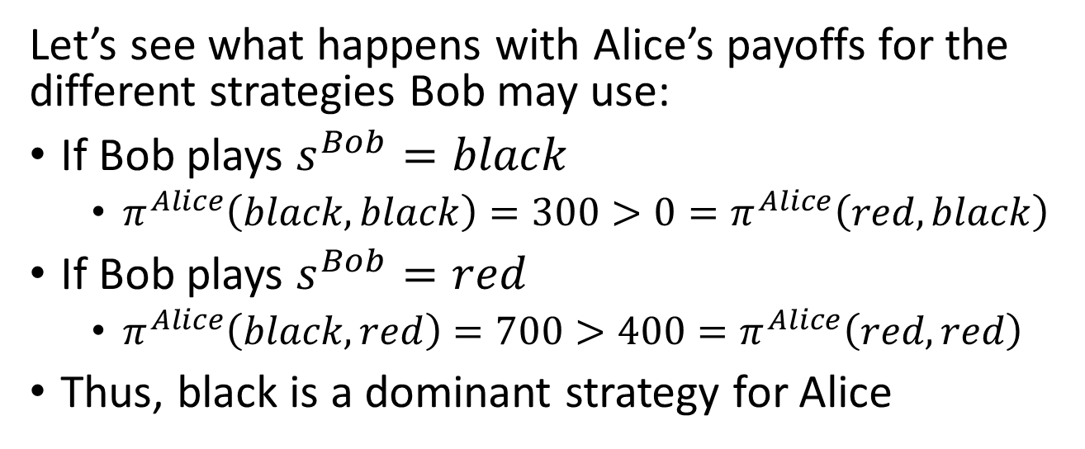
Dominant Strategies
 | Bob
Alice |  | Red | Black
 | Red | (400, 400) | (0, 700)
 | Black | (700, 0) | (300, 300)
Let’s see what happens with Alice’s payoffs for the different strategies Bob may use:
If Bob plays $s^{Bob}=black$
  $π^{Alice}\left(black,black\right)=300>0=π^{Alice}\left(red, black\right)$
If Bob plays $s^{Bob}=red$
  $π^{Alice}\left(black,red\right)=700>400=π^{Alice}\left(red, red\right)$
Thus, black is a dominant strategy for Alice

Slide 14
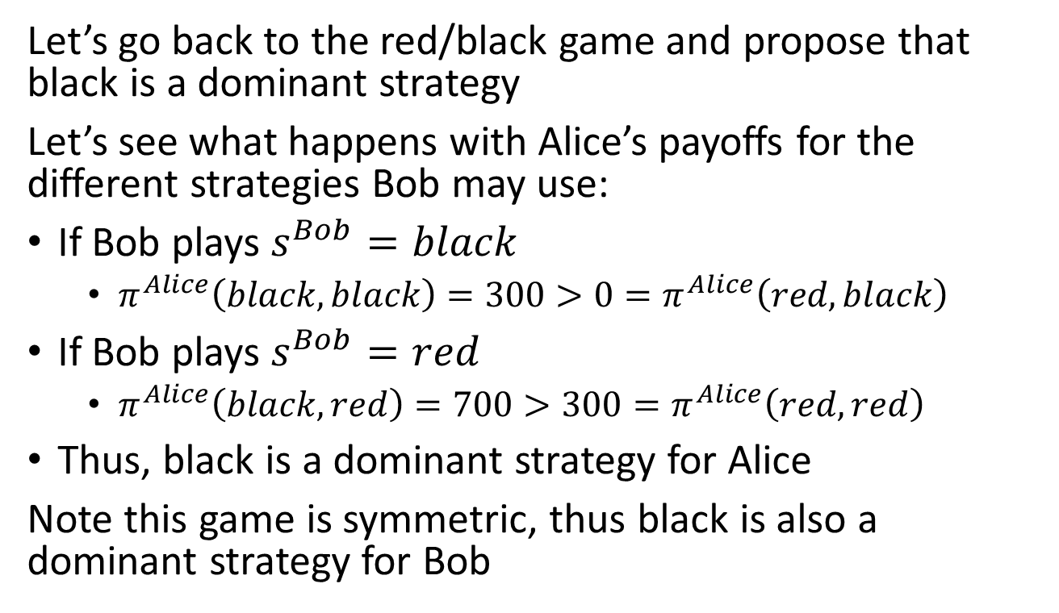
Dominant Strategies
Let’s go back to the red/black game and propose that black is a dominant strategy
Let’s see what happens with Alice’s payoffs for the different strategies Bob may use:
If Bob plays $s^{Bob}=black$
  $π^{Alice}\left(black,black\right)=300>0=π^{Alice}\left(red, black\right)$
If Bob plays $s^{Bob}=red$
  $π^{Alice}\left(black,red\right)=700>300=π^{Alice}\left(red, red\right)$
Thus, black is a dominant strategy for Alice
Note this game is symmetric, thus black is also a dominant strategy for Bob

Slide 15
Example 1
Alice and Bob are deciding what to do during the weekend. Alice would prefer to go skiing and Bob would prefer to stay home and watch a movie. They both want to do something together and would not enjoy their weekend if they go separate ways. Let’s say that the person that gets to do their favorite activity gets a utility of 200 if the other person joins. However, the person that joins their less preferred activity only get a utility of 100. If they go separate ways, they get a utility of zero.

Slide 16
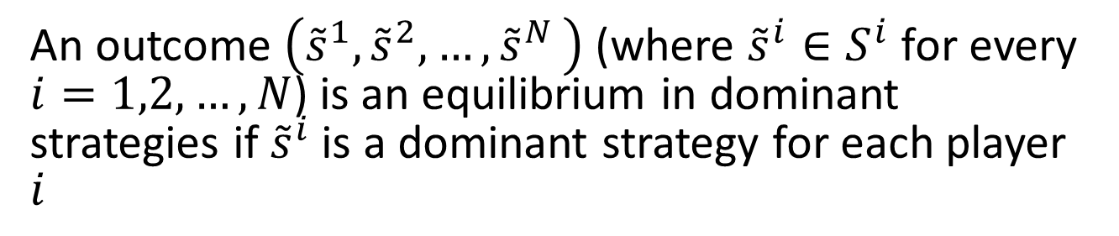
Equilibrium in Dominant Strategies
An outcome $\left({\tilde{s}}^{1},{\tilde{s}}^{2}{,…,\tilde{s}}^{N}\right)$ (where ${\tilde{s}}^{i}∈S^{i}$ for every $i=1,2,…,N$) is an equilibrium in dominant strategies if ${\tilde{s}}^{i}$ is a dominant strategy for each player $i$
 | Bob
Alice |  | Skiing | Movie
 | Skiing | (200, 100) | (0, 0)
 | Movie | (0, 0) | (100, 200)
Although an equilibrium in dominant strategies is a reasonable prediction of how people may interact, in many games this equilibrium does not exist

Slide 17
Example 2
In the following game, assume you are player 1. What strategy will you play:
 | Player 2
Player 1 |  | Left | Right
 | Up | (8, 10) | (-100, 9)
 | Down | (7, 6) | (6, 5)

Slide 18
Example 3
In the following game, assume you are player 2. What strategy will you play:
 | Player 2
Player 1 |  | Left | Right
 | Up | (8, 10) | (-100, 9)
 | Down | (7, 6) | (6, 5)

Slide 19
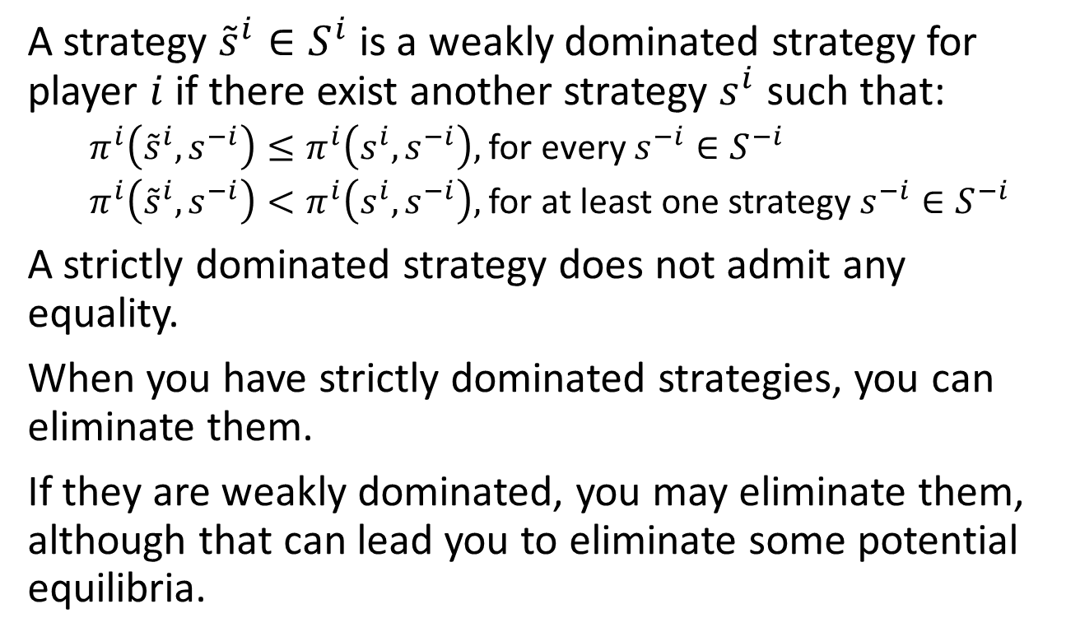
Dominated Strategies
A strategy ${\tilde{s}}^{i}∈S^{i}$ is a weakly dominated strategy for player $i$if there exist another strategy $s^{i}$ such that:
  $π^{i}\left({\tilde{s}}^{i},s^{−i}\right)≤π^{i}\left(s^{i},s^{−i}\right),$ for every $s^{−i}∈S^{−i}$
  $π^{i}\left({\tilde{s}}^{i},s^{−i}\right)<π^{i}\left(s^{i},s^{−i}\right),$ for at least one strategy $s^{−i}∈S^{−i}$
A strictly dominated strategy does not admit any equality.
When you have strictly dominated strategies, you can eliminate them.
If they are weakly dominated, you may eliminate them, although that can lead you to eliminate some potential equilibria.

Slide 20
Iterative Elimination of Dominated Strategies
 | Player 2
Player 1 |  | Left | Right
 | Up | (8, 10) | (-100, 9)
 | Down | (7, 6) | (6, 5)
In the full game, there is no strategy that is dominated for player 1:
  If player 2 plays Left, player 1 should play Up
  If player 2 plays Right, player 1 should play Down
But playing Right is dominated for Player 2:
  If player 1 plays Up or Down, player 2 should play Left
We can delete Right and now (Left, Up) is an equilibrium in dominant strategies

Slide 21
Iterative Elimination of Dominated Strategies
 | Bob
Alice |  | Skiing | Movie
 | Skiing | (200, 100) | (0, 0)
 | Movie | (0, 0) | (100, 200)
In a game like this there is dominated strategies:
  If Alice goes skiing, Bob should go skiing
  If Alice goes movies, Bob should go movies
  If Bob goes skiing, Alice should go skiing
  If Bob goes moving, Alice should go movies
Thus, there is no equilibrium in dominant strategies, although it seems fairly obvious that (Skiing, Skiing) and (Movies, Movies) are good outcomes.

Slide 22
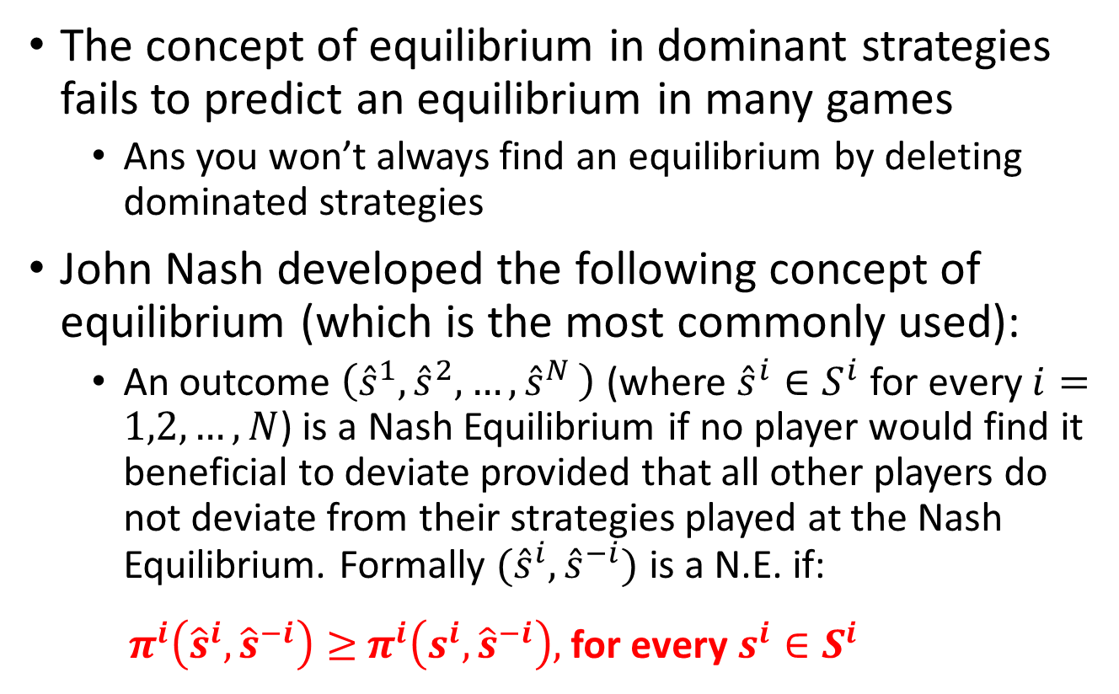
Nash Equilibrium
The concept of equilibrium in dominant strategies fails to predict an equilibrium in many games
  Ans you won’t always find an equilibrium by deleting dominated strategies
John Nash developed the following concept of equilibrium (which is the most commonly used):
  An outcome $\left({\hat{s}}^{1},{\hat{s}}^{2}{,…,\hat{s}}^{N}\right)$ (where ${\hat{s}}^{i}∈S^{i}$ for every $i=1,2,…,N$) is a Nash Equilibrium if no player would find it beneficial to deviate provided that all other players do not deviate from their strategies played at the Nash Equilibrium. Formally ${(\hat{s}}^{i},{\hat{s}}^{−i})$ is a N.E. if:
  ${ π}^{i}\left({\hat{s}}^{i},{\hat{s}}^{−i}\right)≥$ $π^{i}\left(s^{i},{\hat{s}}^{−i}\right),$ for every $s^{i}∈S^{i}$

Slide 23
Nash Equilibrium
Most common way to find if an outcome is a Nash Equilibrium is to check if any player has incentives to deviate
 | Bob
Alice |  | Skiing | Movie
 | Skiing | (200, 100) | (0, 0)
 | Movie | (0, 0) | (100, 200)
Nash Equilibrium need not be unique
Nash Equilibrium does not always exist

Slide 24

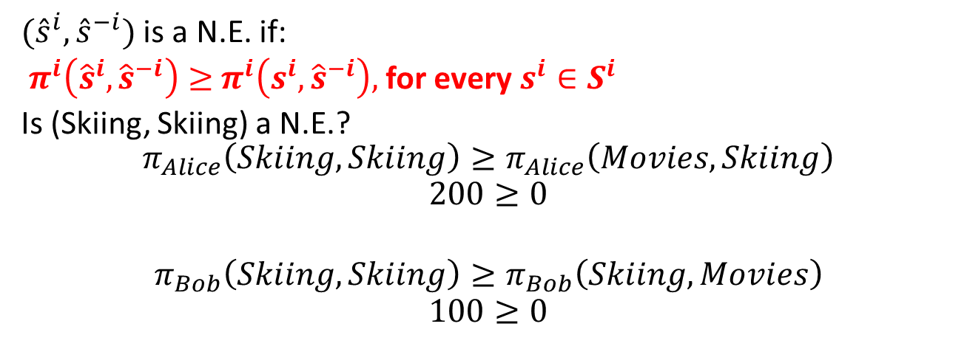
Nash Equilibrium
 | Bob
Alice |  | Skiing | Movie
 | Skiing | (200, 100) | (0, 0)
 | Movie | (0, 0) | (100, 200)
${(\hat{s}}^{i},{\hat{s}}^{−i})$ is a N.E. if:
${ π}^{i}\left({\hat{s}}^{i},{\hat{s}}^{−i}\right)≥$ $π^{i}\left(s^{i},{\hat{s}}^{−i}\right),$ for every $s^{i}∈S^{i}$
Is (Skiing, Skiing) a N.E.?
$$π_{Alice}\left(Skiing, Skiing\right)≥π_{Alice}\left(Movies, Skiing\right)$$
$$200≥0$$
$$π_{Bob}\left(Skiing, Skiing\right)≥π_{Bob}\left(Skiing, Movies\right)$$
$$100≥0$$

Slide 25
Example 4
Let’s say now that Alice and Bob had an argument over what to do. Alice still wants to something with Bob. But Bob now wants to something alone
 | Bob
Alice |  | Skiing | Movie
 | Skiing | (200, 0) | (0, 200)
 | Movie | (0, 100) | (100, 0)

Slide 26
Non-Existence of Nash Eq.
Let’s say now that Alice and Bob had an argument over what to do. Alice still wants to something with Bob. But Bob now wants to something alone
 | Bob
Alice |  | Skiing | Movie
 | Skiing | (200, 0) | (0, 200)
 | Movie | (0, 100) | (100, 0)
In this example there isn’t an equilibrium (in pure strategies)
At every possible outcome, one of the players would like to deviate

Slide 27
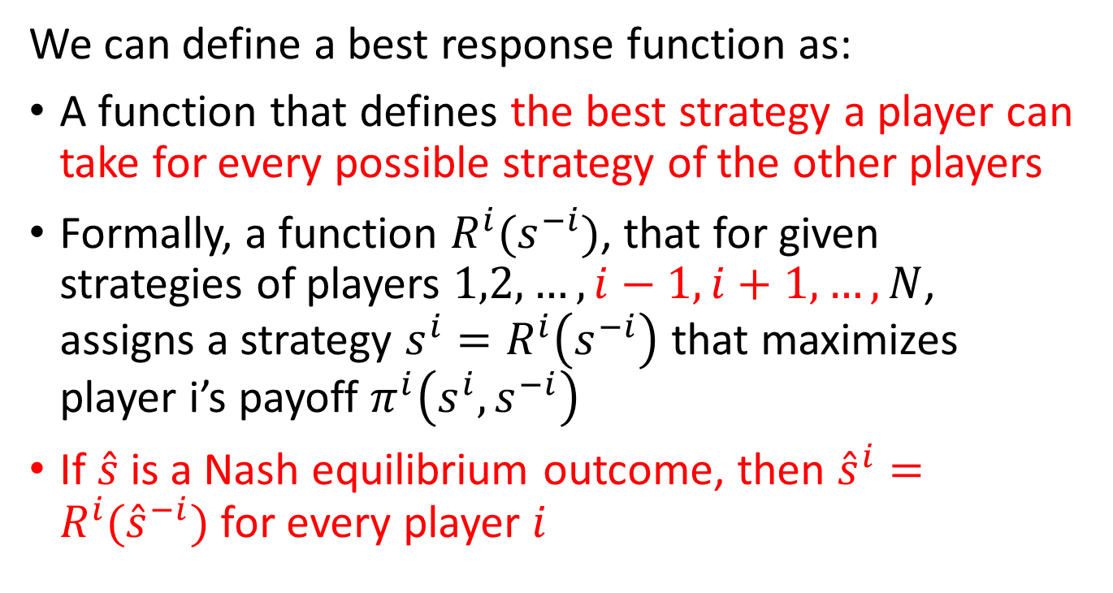
Best response functions
We can define a best response function as:
A function that defines the best strategy a player can take for every possible strategy of the other players
Formally, a function $R^{i}(s^{−i})$, that for given strategies of players $1,2,…,i−1,i+1,…,N$, assigns a strategy $s^{i}=R^{i}\left(s^{−i}\right)$ that maximizes player i’s payoff $π^{i}\left(s^{i}, s^{−i}\right)$
If $\hat{s}$ is a Nash equilibrium outcome, then ${\hat{s}}^{i}=R^{i}({\hat{s}}^{−i})$ for every player $i$

Slide 28






Best Response Function
Going back to the skiing/movies game:
 | Bob
Alice |  | Skiing | Movies
 | Skiing | (200, 100) | (0, 0)
 | Movies | (0, 0) | (100, 200)
{
$$skiing if s^{Bob}=skiing$$
$$R^{Alice}\left(s^{Bob}\right)=$$
$$movies if s^{Bob}=movies$$
and
{
$$skiing if s^{Alice}=skiing$$
$$R^{Bob}\left(s^{Alice}\right)=$$
$$movies if s^{Alice}=movies$$

Slide 29
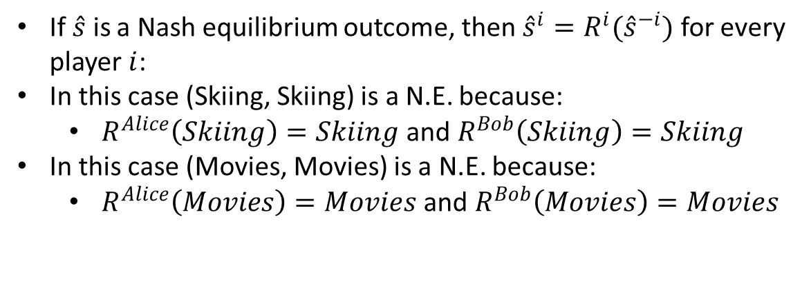
Best Response Function
Going back to the skiing/movies game:
 | Bob
Alice |  | Skiing | Movies
 | Skiing | (200, 100) | (0, 0)
 | Movies | (0, 0) | (100, 200)
If $\hat{s}$ is a Nash equilibrium outcome, then ${\hat{s}}^{i}=R^{i}({\hat{s}}^{−i})$ for every player $i$:
In this case (Skiing, Skiing) is a N.E. because:
  $R^{Alice}\left(Skiing\right)=Skiing$ and $R^{Bob}\left(Skiing\right)=Skiing$
In this case (Movies, Movies) is a N.E. because:
  $R^{Alice}\left(Movies\right)=Movies$ and $R^{Bob}\left(Movies\right)=Movies$

Slide 30
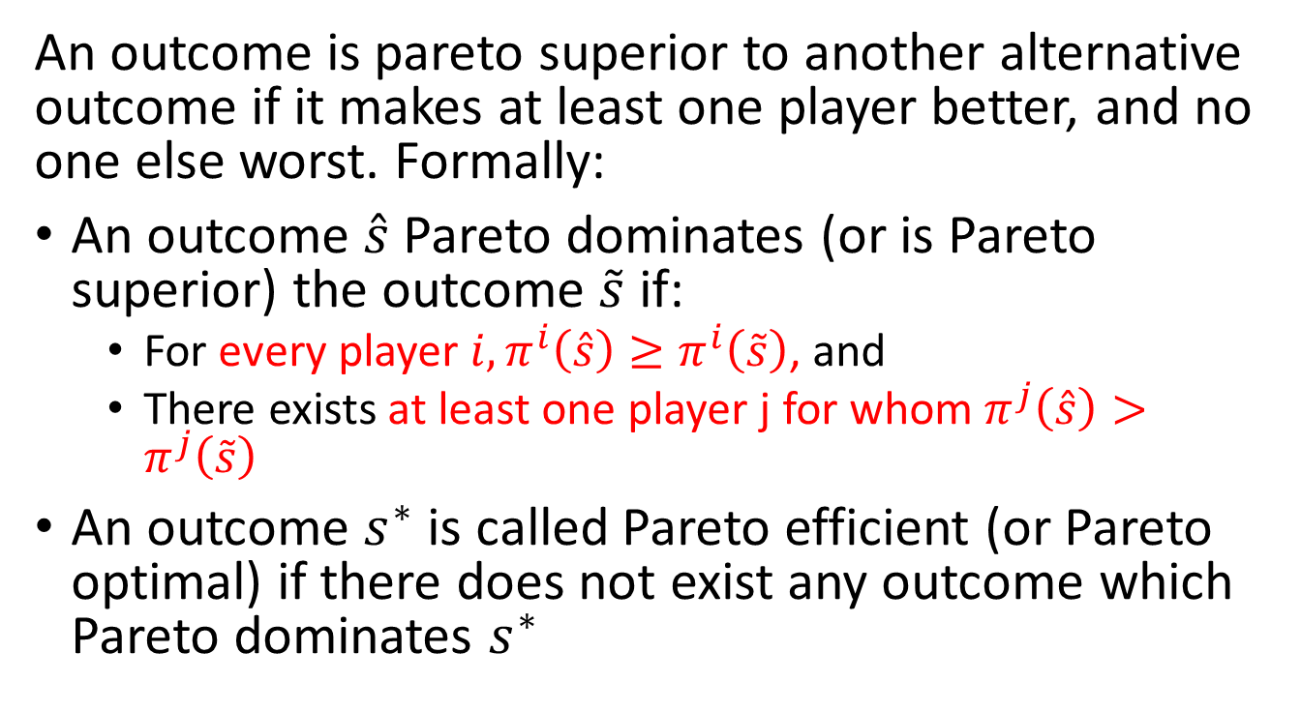
Pareto Comparisons
An outcome is pareto superior to another alternative outcome if it makes at least one player better, and no one else worst. Formally:
An outcome $\hat{s}$Pareto dominates (or is Pareto superior) the outcome $\tilde{s}$ if:
  For every player $i, π^{i}\left(\hat{s}\right)≥π^{i}\left(\tilde{s}\right)$, and
  There exists at least one player j for whom $π^{j}\left(\hat{s}\right)>π^{j}\left(\tilde{s}\right)$
An outcome $s^{∗}$ is called Pareto efficient (or Pareto optimal) if there does not exist any outcome which Pareto dominates $s^{∗}$

Slide 31
Pareto Efficiency and Equilibrium
An outcome that is pareto efficiency is not necessary and equilibrium
For example, in the Red/Black game, Black/Black is pareto dominated by Red/Red, but the only equilibrium in the game is Black/Black
 | Bob
Alice |  | Red | Black
 | Red | (400, 400) | (0, 700)
 | Black | (700, 0) | (300, 300)

Slide 32
Recap from Last Lecture
Strategic games of complete information:
  Players choose simultaneously, and we assume they are rational and know the structure, the rules, and the payoffs of the game.
We talked about different equilibria:
  Dominant strategies
  Iterated elimination of dominated strategies
  Nash equilibrium
We talked about efficiency
  Outcomes in which you cannot find another outcomes that doesn’t make anyone worse off and that it makes at least 1 player better off.
  Efficiency and equilibrium are different things!

Slide 33
Games of Incomplete Information
So far, we have assumed that all players in the game know the payoff function of all players
Typically, this is not the case as players may have private information
The way this is modelled in game theory is by assuming players have a distribution of payoff functions:
  We say that “Nature” will choose the payoff function
  For example, two different payoff functions with probability p and (1-p)

Slide 34
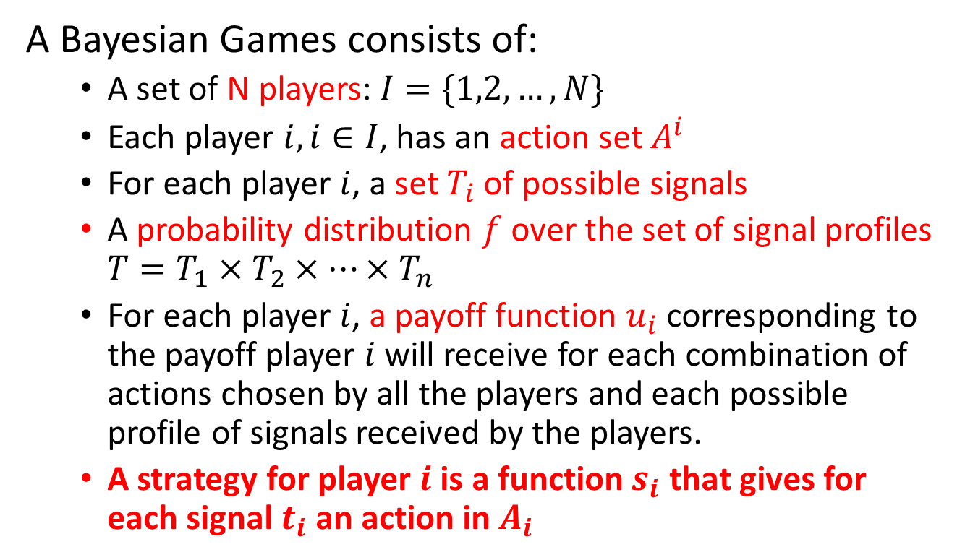
Bayesian Games
A Bayesian Games consists of:
  A set of N players: $I=\{1,2,…,N\}$
  Each player $i,i∈I$, has an action set $A^{i}$
  For each player $i$, a set $T_{i}$ of possible signals
  A probability distribution $f$ over the set of signal profiles $T=T_{1}×T_{2}×…×T_{n}$
  For each player $i$, a payoff function $u_{i}$ corresponding to the payoff player $i$ will receive for each combination of actions chosen by all the players and each possible profile of signals received by the players.
  A strategy for player $i$ is a function $s_{i}$ that gives for each signal $t_{i}$ an action in $A_{i}$

Slide 35
Example 5
Alice is an investor deciding whether to fund or not Bob’s project. Alice doesn’t know if Bob will work hard or not if he gets the investment. A random draw will determine the signal that Bob gets. With probability p Bob will get the signal “hard worker”. The payoffs each receive depends on this signal
Bob is hard worker | Bob is hard worker
 |  | Bob
 |  | Work | Relax
Alice | Invest | 9,10 | 3,4
 | Pass | 5,5 | 5,1
Bob is NO hard worker | Bob is hard worker
 |  | Bob
 |  | Work | Relax
Alice | Invest | 6,3 | 1,6
 | Pass | 5,0 | 5,3

Slide 36
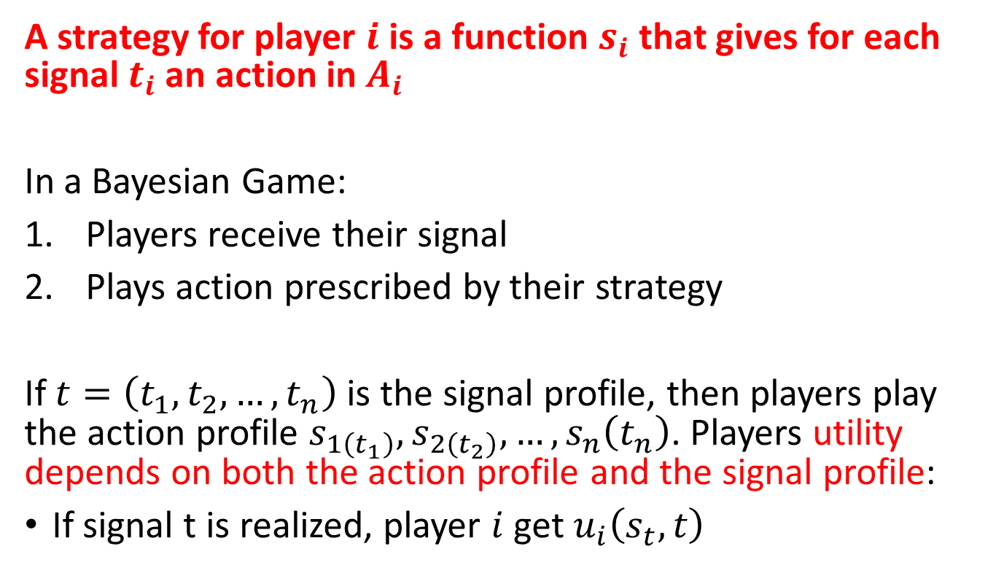
Bayesian Games
A strategy for player $i$ is a function $s_{i}$ that gives for each signal $t_{i}$ an action in $A_{i}$
In a Bayesian Game:
Players receive their signal
Plays action prescribed by their strategy
If $t=\left(t_{1},t_{2},…,t_{n}\right)$ is the signal profile, then players play the action profile $s_{1\left(t_{1}\right)},s_{2\left(t_{2}\right)},…,s_{n}\left(t_{n}\right)$. Players utility depends on both the action profile and the signal profile:
If signal t is realized, player $i$get $u_{i}\left(s_{t},t\right)$

Slide 37
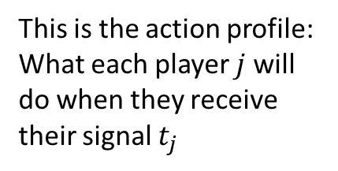
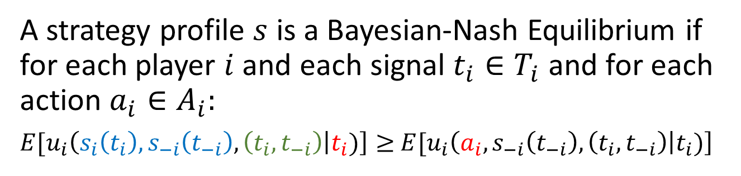
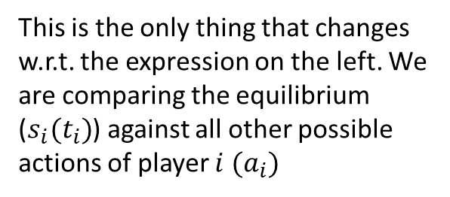
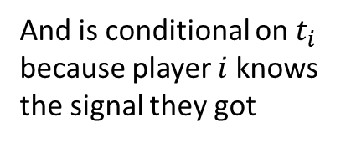
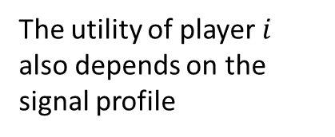
Bayesian-Nash Equilibrium
A strategy profile $s$ is a Bayesian-Nash Equilibrium if for each player $i$ and each signal $t_{i}∈T_{i}$ and for each action $a_{i}∈A_{i}:$
$E[u_{i}\left(s_{i}\left(t_{i}\right),s_{−i}\left(t_{−i}\right),\left(t_{i},t_{−i}\right) | t_{i})\right]≥$ $E[u_{i}\left(a_{i},s_{−i}\left(t_{−i}\right),\left(t_{i},t_{−i}\right) | t_{i})\right]$
This is the action profile: What each player $j$ will do when they receive their signal $t_{j}$
This is the only thing that changes w.r.t. the expression on the left. We are comparing the equilibrium ($s_{i}(t_{i})$) against all other possible actions of player $i$ ${(a}_{i})$
The utility of player $i$ also depends on the signal profile
And is conditional on $t_{i}$ because player $i$ knows the signal they got

Slide 38
Find the Bayesian-Nash Equilibrium
Alice is an investor deciding whether to fund or not Bob’s project. Alice doesn’t know if Bob will work hard or not if he gets the investment. A random draw will determine the signal that Bob gets. With probability p Bob will get the signal “hard worker”. The payoffs each receive depends on this signal
Bob is hard worker | Bob is hard worker
 |  | Bob
 |  | Work | Relax
Alice | Invest | 9,10 | 3,4
 | Pass | 5,5 | 5,1
Bob is NO hard worker | Bob is hard worker
 |  | Bob
 |  | Work | Relax
Alice | Invest | 6,3 | 1,6
 | Pass | 5,0 | 5,3

Slide 39
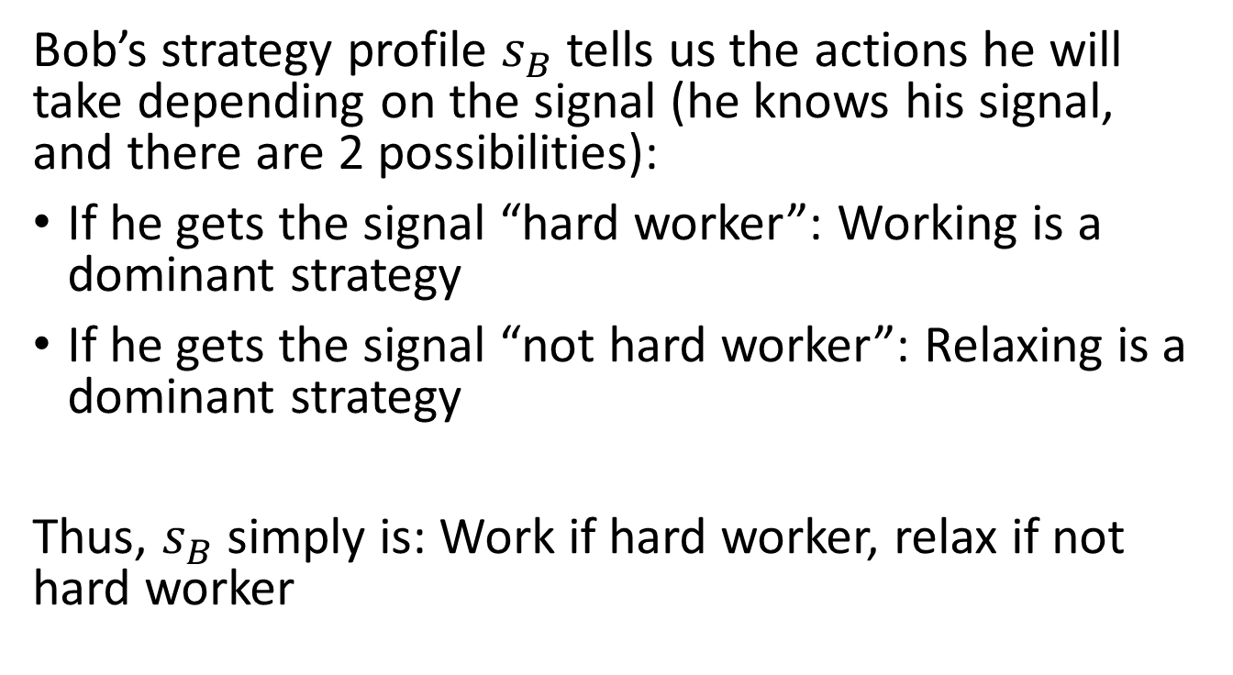
Find the Bayesian-Nash Equilibrium
Bob’s strategy profile $s_{B}$ tells us the actions he will take depending on the signal (he knows his signal, and there are 2 possibilities):
If he gets the signal “hard worker”: Working is a dominant strategy
If he gets the signal “not hard worker”: Relaxing is a dominant strategy
Thus, $s_{B}$ simply is: Work if hard worker, relax if not hard worker

Slide 40
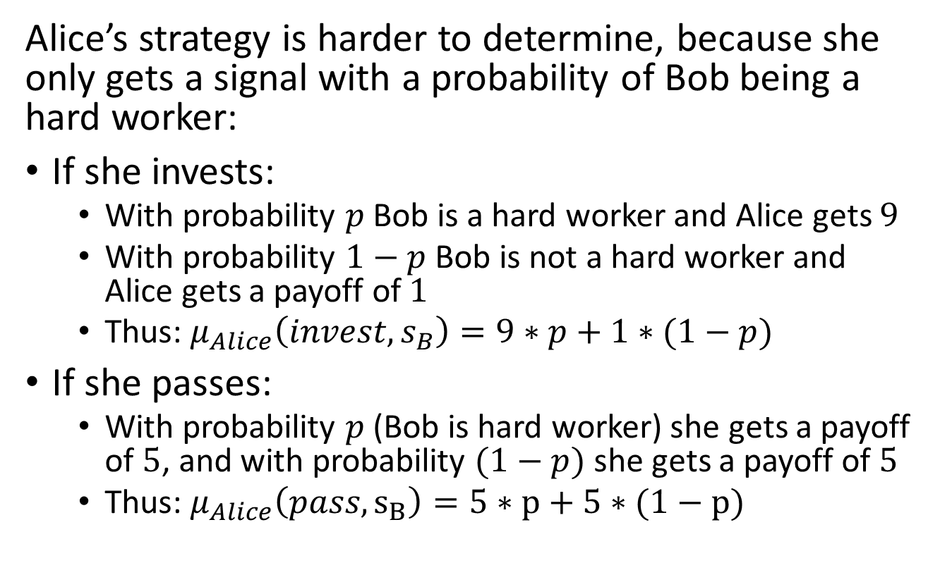
Find the Bayesian-Nash Equilibrium
Alice’s strategy is harder to determine, because she only gets a signal with a probability of Bob being a hard worker:
If she invests:
  With probability $p$ Bob is a hard worker and Alice gets $9$
  With probability $1−p$ Bob is not a hard worker and Alice gets a payoff of $1$
  Thus: $μ_{Alice}\left(invest,s_{B}\right)=9∗p+1∗(1−p)$
If she passes:
  With probability $p$ (Bob is hard worker) she gets a payoff of $5$, and with probability $(1−p)$ she gets a payoff of $5$
  Thus: $μ_{Alice}\left(pass,s_{B}\right)=5∗p+5∗(1−p)$

Slide 41
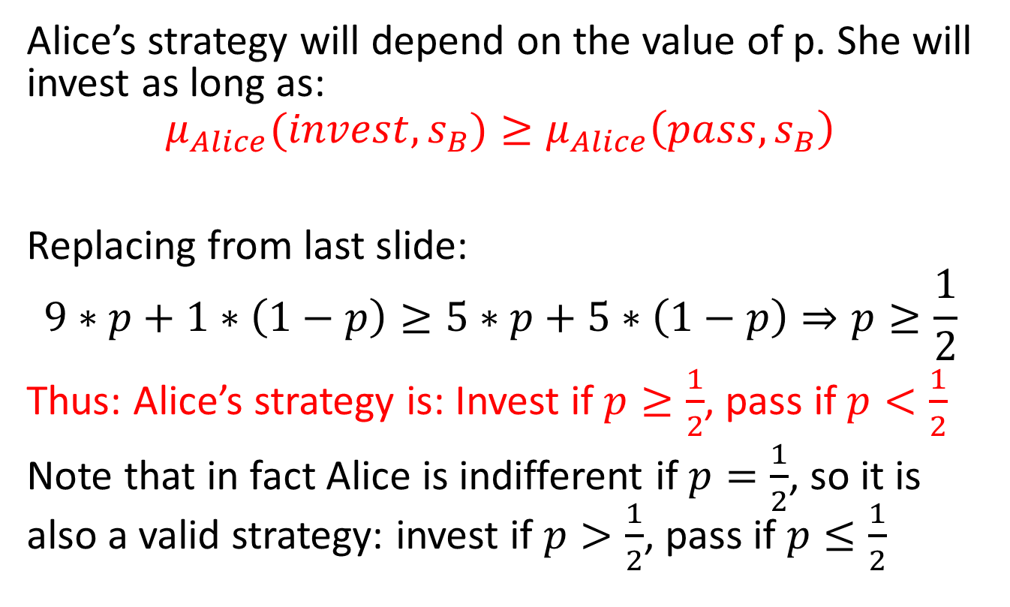
Find the Bayesian-Nash Equilibrium
Alice’s strategy will depend on the value of p. She will invest as long as:
$$μ_{Alice}(invest,s_{B})≥μ_{Alice}\left(pass,s_{B}\right)$$
Replacing from last slide:
$$9∗p+1∗\left(1−p\right)≥5∗p+5∗\left(1−p\right)⇒p≥\frac{1}{2}$$
Thus: Alice’s strategy is: Invest if $p≥\frac{1}{2}$, pass if $p<\frac{1}{2}$
Note that in fact Alice is indifferent if $p=\frac{1}{2}$, so it is also a valid strategy: invest if $p>\frac{1}{2}$, pass if $p≤\frac{1}{2}$

Slide 42
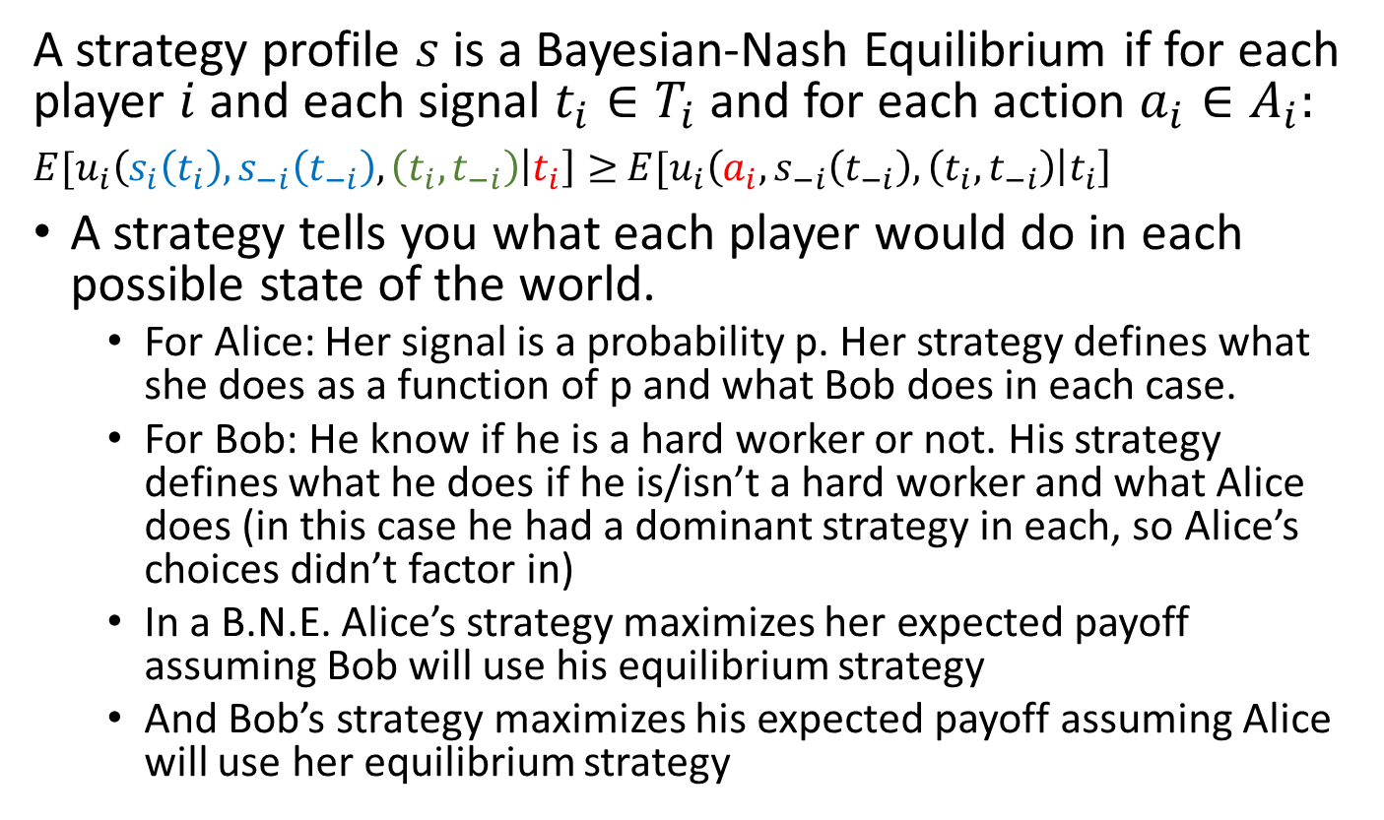
What defines an equilibrium in Bayesian-Nash game
A strategy profile $s$ is a Bayesian-Nash Equilibrium if for each player $i$ and each signal $t_{i}∈T_{i}$ and for each action $a_{i}∈A_{i}:$
$E[u_{i}\left(s_{i}\left(t_{i}\right),s_{−i}\left(t_{−i}\right),\left(t_{i},t_{−i}\right) | t_{i}\right]≥$ $E[u_{i}\left(a_{i},s_{−i}\left(t_{−i}\right),\left(t_{i},t_{−i}\right) | t_{i}\right]$
A strategy tells you what each player would do in each possible state of the world.
  For Alice: Her signal is a probability p. Her strategy defines what she does as a function of p and what Bob does in each case.
  For Bob: He know if he is a hard worker or not. His strategy defines what he does if he is/isn’t a hard worker and what Alice does (in this case he had a dominant strategy in each, so Alice’s choices didn’t factor in)
  In a B.N.E. Alice’s strategy maximizes her expected payoff assuming Bob will use his equilibrium strategy
  And Bob’s strategy maximizes his expected payoff assuming Alice will use her equilibrium strategy

Slide 43
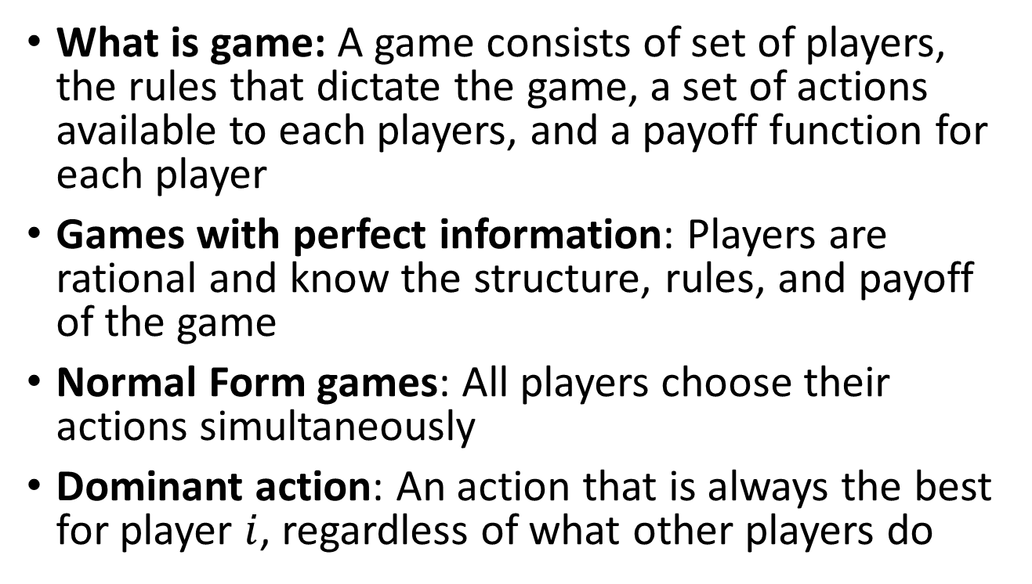
Game Theory Recap Summary
What is game: A game consists of set of players, the rules that dictate the game, a set of actions available to each players, and a payoff function for each player
Games with perfect information: Players are rational and know the structure, rules, and payoff of the game
Normal Form games: All players choose their actions simultaneously
Dominant action: An action that is always the best for player $i$, regardless of what other players do

Slide 44
Game Theory Recap Summary
Nash Equilibrium: An outcome in which no player has incentives to deviate, provided that all other players do not deviate as well
Bayesian Games: Games of incomplete information. Players do not know the payoffs of other players (only a probability distribution)
Bayesian-Nash Equilibrium: A strategy profile (depends on both actions and signals profiles) in which no player has an incentive to deviate, provided that the others player do not deviate
Pareto efficient: An outcome in which you cannot find another outcomes that doesn’t make anyone worse off and that makes at least 1 player better off

Slide 45
Why Game Theory?
We have been looking at game theory as a way to model strategic interactions
There is a game with certain known rules that dictate how players interact. We would like game theory to predict:
  Dominant strategies: Actions that are always the best option, despite what others do
  Nash (or Bayesian Nash) equilibrium: The action that is the best strategy considering the actions of the other players (or a correct probability assessment of what others will do)
In mechanism design we flip the problem

Slide 46
Mechanism Design
Goal is to design games that will lead to outcomes with characteristic we prefer
We have to take into account that people will be strategic in their actions, and choose to withhold or misrepresent information
Objectives depend on who is designing the game. Examples could include:
  Maximize sellers’ revenue in an auction
  Produce the more equitable allocation in a matching problem
Auctions and matching are special cases of mechanism design

Slide 47

Example
I want to convince my kids to eat vegetable. My options are carrots or peas. Problem is, some of my kids like carrots, other peas. How do we choose:
I ask them to rank their preferences and choose the vegetable preferred by most
I ask them to write down a random number. If the sum of all submitted numbers is even, I do carrots, if it odd, I do peas

Slide 48
Some definitions
Principal: Design the game. In the example: Parent
Agents: Those playing the game. In the example: Kids
Agents have some private information. In the example: Each kid knows what they like (carrots or peas)
Agents give the principal messages, and the principal decides the outcome based on a function of the received messages
  In the example: Game 1: Possible messages was carrots or peas. Game 2: Message was the number they said

Slide 49
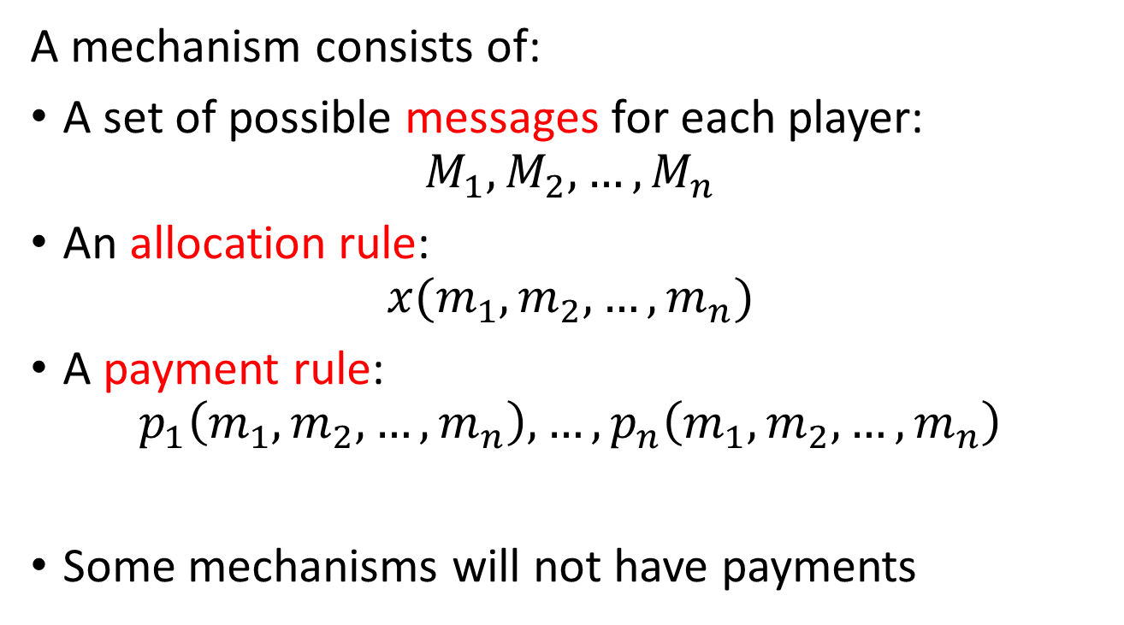
Mechanism
A mechanism consists of:
A set of possible messages for each player:
$M_{1},M_{2},…,M_{n}$
An allocation rule:
$x(m_{1},m_{2},…,m_{n})$
A payment rule:
$p_{1}\left(m_{1},m_{2},…,m_{n}\right),…,p_{n}\left(m_{1},m_{2},…,m_{n}\right)$
Some mechanisms will not have payments

Slide 50
Examples of Mechanisms
Auction Problems:
  Private information: A person’s valuation for the item
  Messages: Bids
  Auction mechanism: Determines who gets the item, and how much they have to pay
Matching Problems:
  Private information: Person’s preferences over matches/items
  Messages: Stated preference (that may or may not be truthful)
  Matching mechanism: Algorithm creating the matches

Slide 51
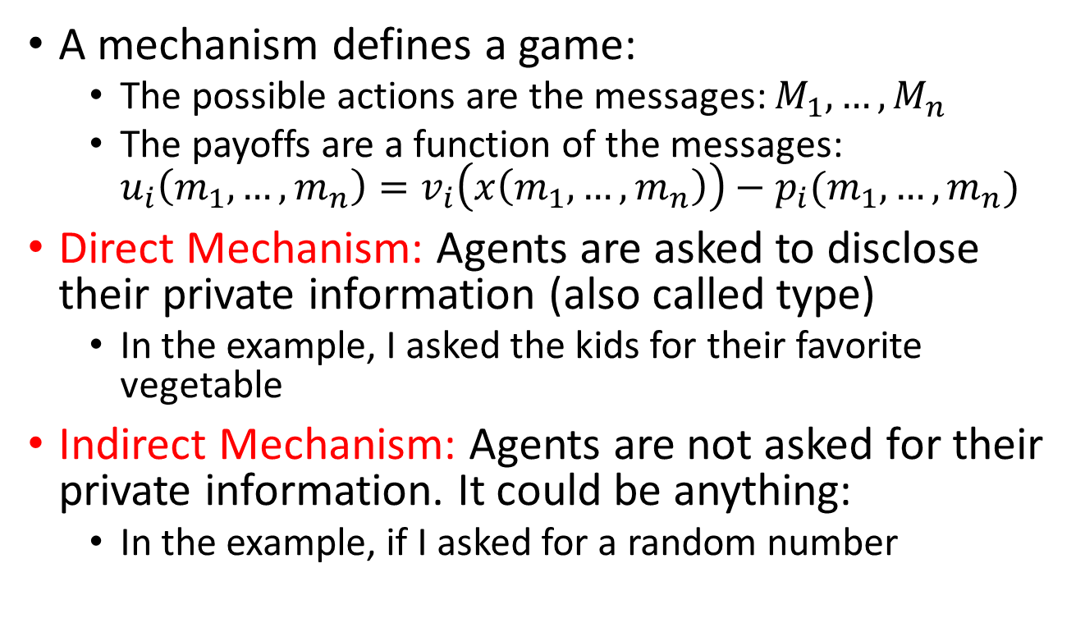
Mechanism and Game Theory
A mechanism defines a game:
  The possible actions are the messages: $M_{1},…,M_{n}$
  The payoffs are a function of the messages:
  $u_{i}\left(m_{1},…,m_{n}\right)=v_{i}\left(x\left(m_{1},…,m_{n}\right)\right)−p_{i}(m_{1},…,m_{n})$
Direct Mechanism: Agents are asked to disclose their private information (also called type)
  In the example, I asked the kids for their favorite vegetable
Indirect Mechanism: Agents are not asked for their private information. It could be anything:
  In the example, if I asked for a random number

Slide 52
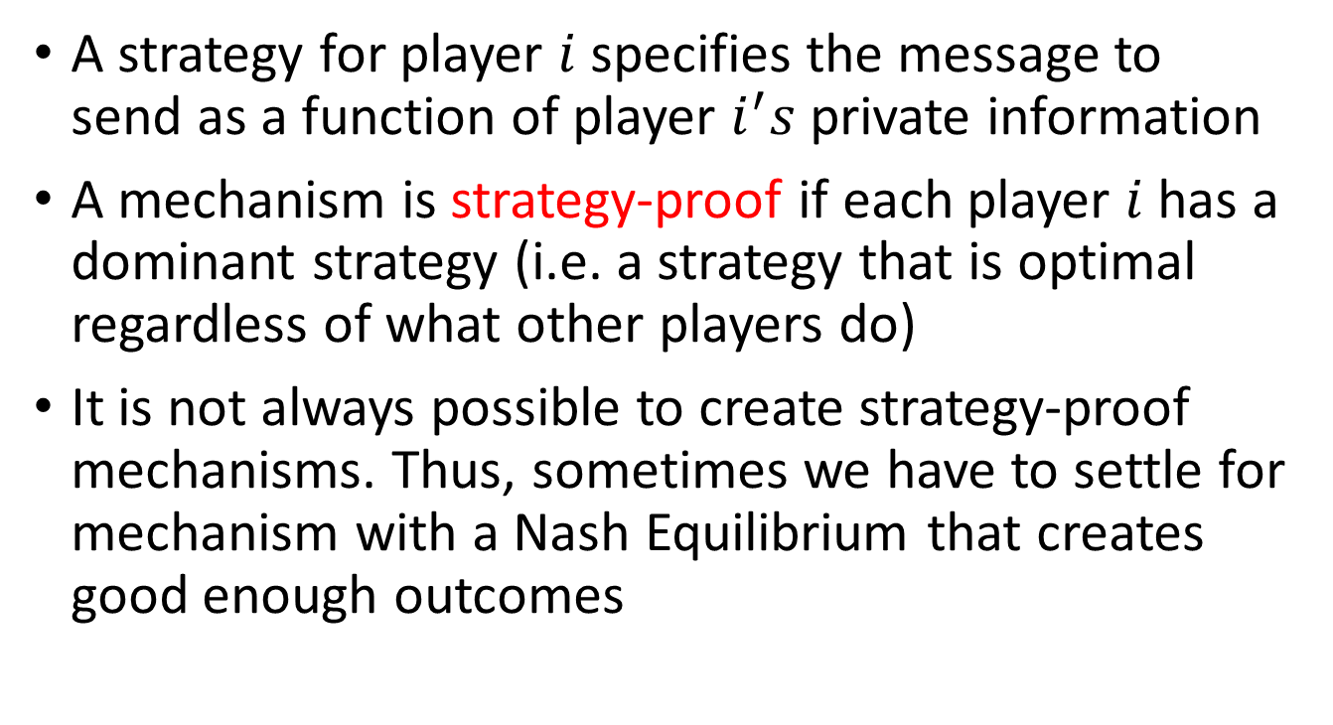
Strategy-proof mechanisms
A strategy for player $i$ specifies the message to send as a function of player $i^{′}s$ private information
A mechanism is strategy-proof if each player $i$ has a dominant strategy (i.e. a strategy that is optimal regardless of what other players do)
It is not always possible to create strategy-proof mechanisms. Thus, sometimes we have to settle for mechanism with a Nash Equilibrium that creates good enough outcomes

Slide 53
Applying Game Theory to Market Design
In existing markets:
  Useful to model how participants will behave based on the “rules of the game”. With this information we can determine if the market is working well or not
When designing new markets:
  We need to understand the problem to be solved and the desired outcomes. Then, look at players, their objectives and incentives. With this information we create rules that would help the market arrive to a desired outcome
Important: Economic theory is just a framework. In market design data and experimentation is typically used to make sure the mechanism works and that the model didn’t miss a critical feature.

